Slide 1





Developing guidelines for health professionals who support parents who have had a loss from a multiple pregnancy
Louise Hayes, Judy Richards, Lisa Crowe, Claire Campbell, Nicholas D Embleton, Judith Rankin

Slide 2
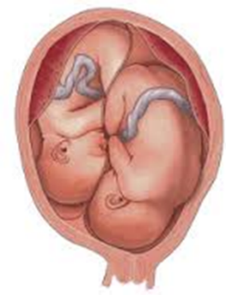
Background
In-depth qualitative study of parents’ and health professionals’ experience of loss from a multiple pregnancy^{1,2}
Parents expect and value emotional work from staff
staff often the only people to have ‘known’ the deceased baby
The way in which staff relate to parents has a major impact on their experience of a difficult and painful time
Staff expressed lack of confidence in dealing with bereaved parents after loss from a twin pregnancy
how to instigate a conversation about the loss?
‘We don’t seem to be able to deal with both [grief and joy]. We are great dealing with the grief if there is just one [singleton] baby that has died and we are great at being delighted and happy when it all goes fine. We are not managing the two together very well so I think some training for the staff even just to raise awareness of that’
1. Richards J et al. Mothers' perspectives on the perinatal loss of a co-twin: A qualitative study. BMC Pregnancy & Childbirth. 2015;15:143
2. Richards J et al. Health professionals' perspectives on bereavement following loss from a twin pregnancy Journal of Perinatology. doi:10.1038/jp.2016.13

Slide 3
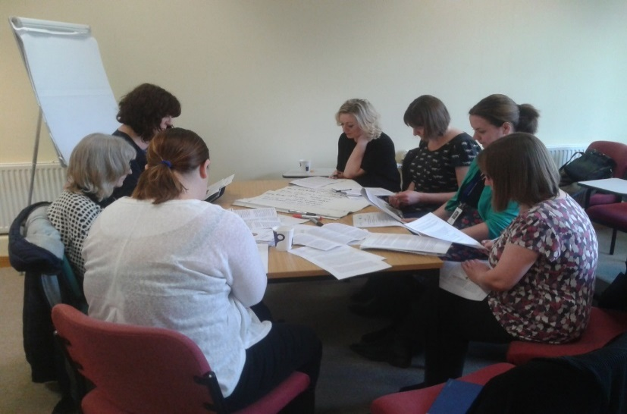
What we did
Co-design of guidelines to support health professionals¹
Scoping study²
Review of transcripts from previous study – identification of ‘training points’
Draft guidelines circulated (health professionals, patient representatives and representatives from patient organisations)
Workshop to develop ‘final’ guidelines
Hayes L, Richards J, Crowe L, Campbell C, Embleton ND, Rankin J. Development of guidelines for health professionals supporting parents who have lost a baby from a multiple pregnancy. Infant 2015, 11(5), 164-166.
Crowe L et al. Investigating available resources on loss from a multiple pregnancy to inform practice. Infant 2015, 11(4), 123-126.

Slide 4

Guideline content
Recognise that the pregnancy is a multiple pregnancy
Acknowledge the bereavement
Provide emotional support to parents
Provide appropriate information to parents
Provide as much continuity as possible
Offer memory making
Handling cot occupancy sensitively
Prepare parents for discharge from hospital

Slide 5

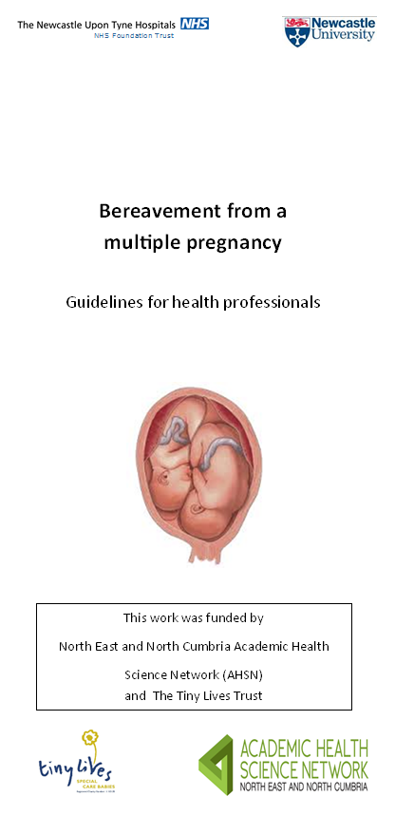
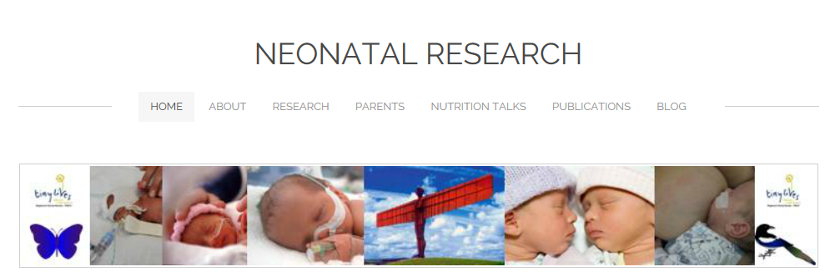
Next steps
Dissemination
Launched in May 2016
Available from http://www.neonatalresearch.net/
Leaflet
Training pack
Assess uptake and impact of guidelines
Continue to develop guidelines in response to feedback

Slide 6


Acknowledgements
We wish to thank all the parents and staff who participated in the qualitative study and who were involved in the co-design of the guidelines, Jane Denton (MBF), our funders and partner organisations.

